Slide 1


Placement Preparation Planner
Preparing for job interviews can be overwhelming. Our Project Placement Preparation Planner is here to help. With quizzes, mock tests, and study material, you'll be ready for any interview.

Slide 2

Introduction
Welcome to the Project Placement Preparation Planner. Our team, led by Tulika Omrey and Smriti Tiwari, has created a platform to help job seekers ace their interviews. Our project supervisor, Dr. Sangeeta Arora, has been instrumental in guiding our efforts.

Slide 3
Technologies and Software Requirements
HTML
CSS
PHP
MySQL
To develop our platform, we have used HTML, CSS, PHP, and MySQL. These technologies help us provide a seamless experience for our users, and enable us to easily manage and store information.

Slide 4



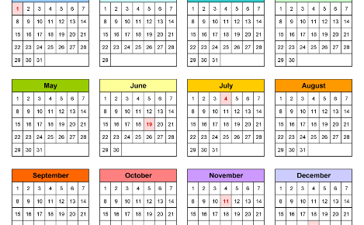
.
Module Description
Quizzes
Mock Tests
Our quizzes are specifically designed to help you assess your skills and knowledge in different areas, so you can identify and work on your weaknesses, and build on your strengths.
We provide simulated interviews through our mock tests, so you can practice in a safe and controlled environment. Our feedback mechanism will help you to identify the areas you need to focus on.
Study Material
Notifications and Reminders
We have compiled a comprehensive library of study material that cover a wide range of topics. You can learn at your own pace and revisit the material as many times as you need to.
Our platform provides a user-friendly calendar to help you plan and manage your preparation process. We also provide timely reminders and notifications to help you stay on track.

Slide 5
Outputs
1
Personalized Learning
Our platform adapts to your learning style, enabling you to focus on the areas where you need the most help.
Higher Success Rate
2
Our users have reported a higher success rate in interviews and placements, compared to those who didn't use our platform.
3
Improved Confidence
By providing a safe and controlled environment to practice in, we've helped our users improve their confidence, resulting in better interview performance.

Slide 6

Conclusion
1
Maximize Your Chances
2
Easy to Use
3
Your Success is Our Success
Our platform is user-friendly and accessible, making it easy for job seekers to prepare for their interviews any time, anywhere.
Job interviews can be stressful, but with our Project Placement Preparation Planner, you can significantly improve your chances of success.
Our team is committed to helping you succeed. We're constantly working to improve our platform to give you the best preparation experience possible.

Slide 7
Gantt Chart
 | Task Name | Week 1 | Week 2 | Week 3 | Week 4 | Week 5 | Week 6 | Week 7 | Week 8
 | Planning
 | Requirement Analysis
 | Design
 | Coding
 | Report Writing

